Slide 1


Power Generation Shipboard Power System Fundamentals Revision of 7 January 2026
Dr. Norbert Doerry
http://doerry.org/norbert/MarineElectricalPowerSystems/index.htm
© 2026 by Norbert Doerry This work is licensed via: CC BY 4.0 (https://creativecommons.org/)

Slide 2
Essential Questions
What prime movers are used onboard ship and why? | Understand
What components comprise Power Generation? | Remember
What fuels do the prime movers use and why? | Understand
How is the fuel rate calculated using an sfc curve? | Apply

Slide 3
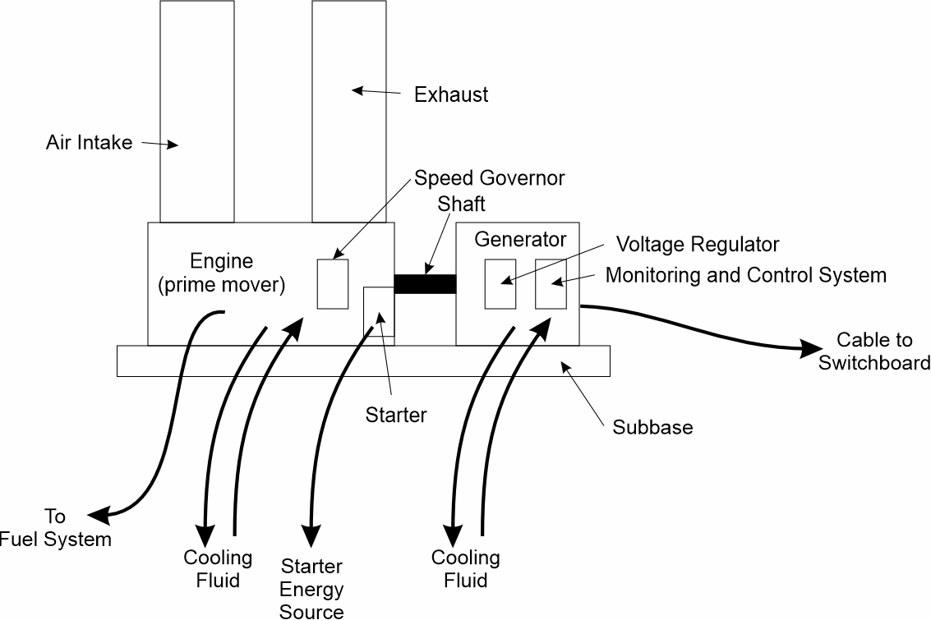
Introduction
Power Generation
Converts energy (not of electrical origin) into electrical energy.
Source of energy is typically chemical in the form of “fuel”
Other sources of energy
Steam (thermal)
Waste heat (thermal)
Solar (radiation)
Wind (kinetic energy)
Generator Set
Most common implementation of Power Generation
Prime mover (usually gas turbine or diesel engine)
Synchronous generator
Supporting auxiliaries and controls
Uncommon implementations of Power Generation
Fuel cells
Photovoltaic systems
Waste heat systems
Wind turbines

Slide 4
Prime Movers
Diesel Engines
Tend to be large and heavy
Usually located low in ship
Good fuel efficiency
Often used to satisfy endurance conditions
Gas Turbines
Smaller and lighter than diesel engines
Usually located low in ship, but may be located higher in ship.
Not as good fuel efficiency as diesel engines
May be used to achieve sustained speed conditions
If significantly higher power levels than endurance conditions
May employ reduction gear to reduce high shaft speed of gas turbine (>3000 rpm) to 1800 rpm to enable use of 4 pole synchronous generator for 60 Hz operation.

Slide 5
Generator Set Components
Engine (prime mover)
Diesel or Gas Turbine typical.
Synchronous generator
For 60 Hz output, RPM is a sub-multiple of 3600 (1800 and 1200 rpm are common).
May require gearbox for gas turbine
Higher frequency (200 to 300 Hz) output desirable for direct conversion to d.c.
Subbase
Rigid structure for other components.
Enable construction, alignment and testing before installation.
Voltage regulator
Controls excitation current in the field winding of the synchronous generator to regulate the output voltage.
Speed governor
Regulates the shaft speed of the prime mover and generator by controlling the fuel rate into the prime mover.
Starter
Provides the mechanical means to start the engine.
Example technologies include air motors and electrical motors.

Slide 6
Generator Set Components (Continued)
Air Intakes and exhaust
Air intakes provide combustion air and cooling air.
Can include a cooling air fan.
Exhaust conveys combustion products and heated air to the exterior of the ship.
Fuel system
Day / Service Tank.
Filters and water separators.
Fuel pumps.
Cooling system
Engines are typically cooled by oil or fresh water (with glycol).
Seawater – oil or Seawater-freshwater heat exchanger transfers heat to the exterior of the ship.
Generators often Totally Enclosed Water – Air cooled (TEWAC).
Air cools the generator.
Seawater – air heat exchanger cools the air.
Monitoring and Control System
Coordinates generator set components.
Communicates with external systems.
Rectifier (d.c. output only)
Creates d.c. voltage for integration into d.c. power systems.

Slide 7
Fuel Cells
Advantages
Clean exhaust – reduce or eliminate NO_{X}, CO₂, SO_{X}, and particulate emissions
High efficiency
Modularity
Low noise and vibration
Disadvantages
Traditional fuels (F76 or MGO) cannot be directly used – must be reformed
Slow dynamic response to transients
Usually require additional energy storage to support required dynamics
Limited industrial base

Slide 8
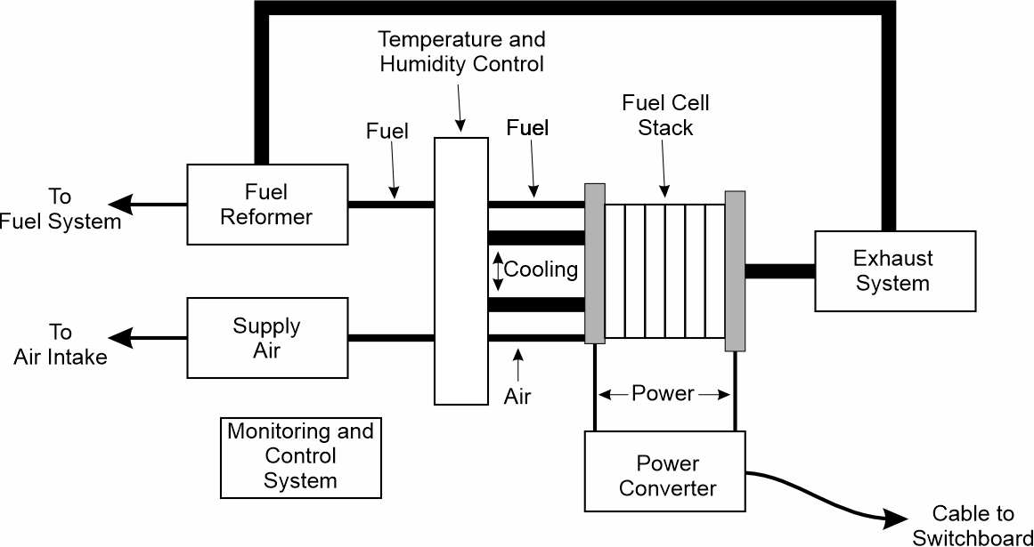
Fuel Cell Components
Fuel cell stack
Power converter
Fuel reformer
Supply air
Temperature and humidity control
Exhaust system
Monitoring and control system

Slide 9
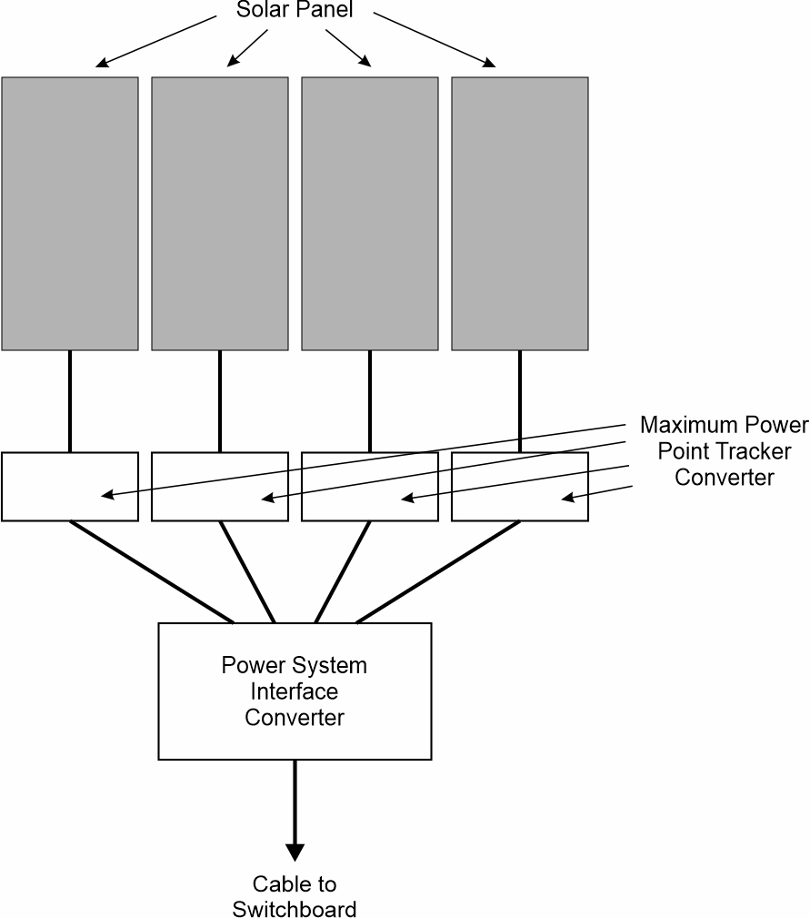
Photovoltaic Systems (Solar Panels)
Convert light directly into electricity
Amount of power and energy produced is usually not large
Augment, rather than replace other sources of power and energy
Special purposes

Slide 10
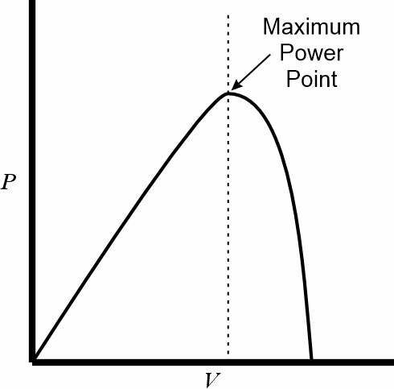
Photovoltaic System Components
Solar Panels
Typically contains a series and parallel network of solar cells.
Power production depends on:
Cleanliness of panels.
Intensity of light.
Angle between the normal angle of the panel with respect to the sun.
Maximum Power Point Tracker Converter
Imposes a voltage on the solar panels to maximize the power produced.
Power System Interface Converter
Converts power from the maximum power point tracker converter to the type of power needed by the power system.
May not be needed if the power from the maximum power point tracker converter meets the applicable interface requirements.

Slide 11
Fuel
Heavy Fuel Oil (HFO)
Remains after crude oil refined has removed lighter components
High viscosity – must be preheated
Inexpensive
May require special scrubbing systems to meet environmental laws
Distillate Fuels (MGO and F76)
Lower viscosity than HFO
More expensive
Easier to meet environmental laws
F76 (and JP5) standard fuel for U.S. Navy
Blended Fuels (mix HFO and MGO)
Viscosity lower than HFO – eliminates need for preheating
Biofuels
Reduces emissions of SO_{X} and CO₂
Limited shelf live (typically 1 year)
May require engine modifications

Slide 12
Fuel (Continued)
Liquid Natural Gas (LNG)
Reduces emission of SO_{X} and CO₂
Requires engines designed to run on LNG
Requires special storage tanks
Methanol (CH₃OH)
Reduces emission of SO_{X} and CO₂
Less impact to ship than LNG
Requires engines designed to run on methanol
Must address high toxicity and high flammability
Ammonia (NH₃)
Eliminates emission of SO_{X} and CO₂
Requires engines designed to run on ammonia
Must address high toxicity and high corrosiveness

Slide 13
Specific Fuel Consumption (SFC) vs Fuel Rate
Specific Fuel Consumption
Fuel Rate (kg/hr) divided by power delivered (kW)
Units kg/kW-hr (or lbs/HP-hr , g/kW-s, etc.)
Depends on fuel used and the operating point of the engine (power and shaft speed)
Inversely proportional to the prime mover efficiency
Relatively constant above about 50% Power
SFC often provided for engines at a few data points
Tends to infinity as one approaches idle power
Idle fuel rate divided by 0 output power.
SFC generally not good for directly modeling fuel rates at low power levels.
Fuel Rates
For many engines, the fuel rate as a function of power delivered is nearly linear (with a y-intercept equal to the idle fuel rate)
For given data points, better to interpolate based on fuel rate rather than SFC
Usually have to convert SFC to a Fuel Rate, then perform linear interpolation

Slide 14
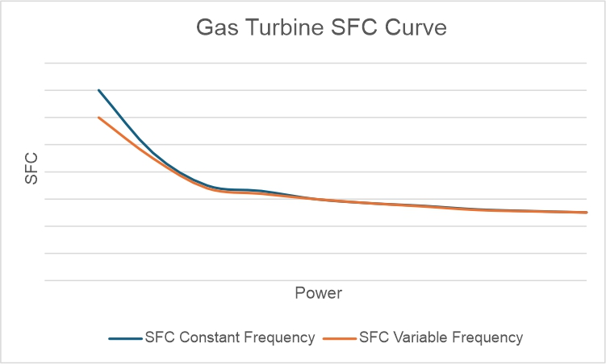
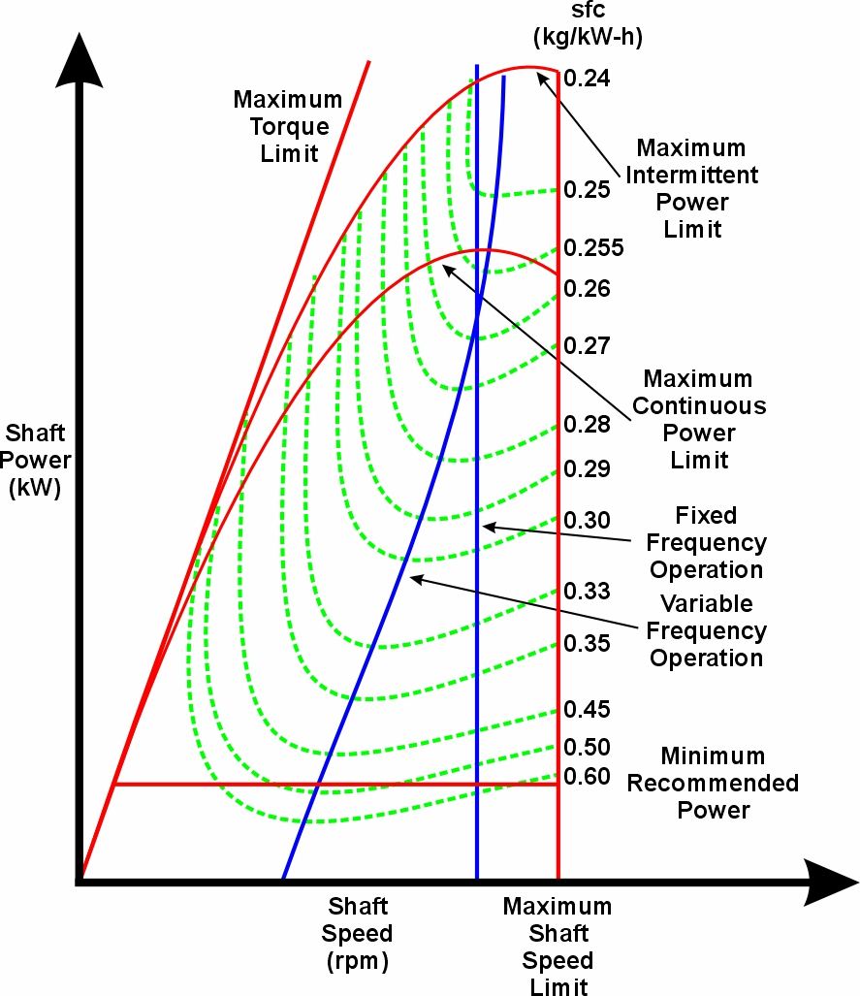
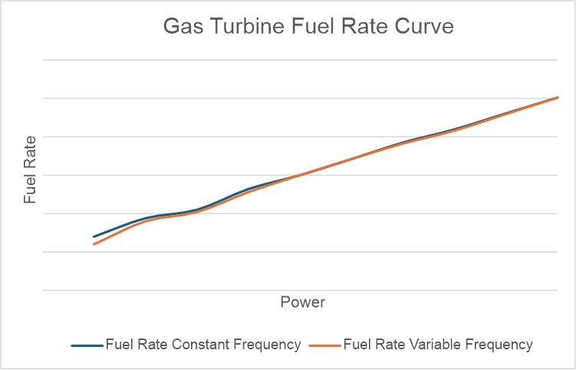
Gas turbine engine map - sfc curve – fuel rate curve
If an engine map is available, plot the load line (shaft power vs shaft speed) on the engine map and interpolate sfc from iso-sfc line to produce sfc vs power curve.
Convert the sfc vs power curve to a fuel rate vs power curve.

Slide 15
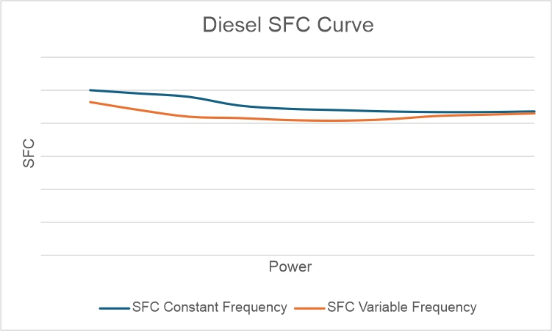
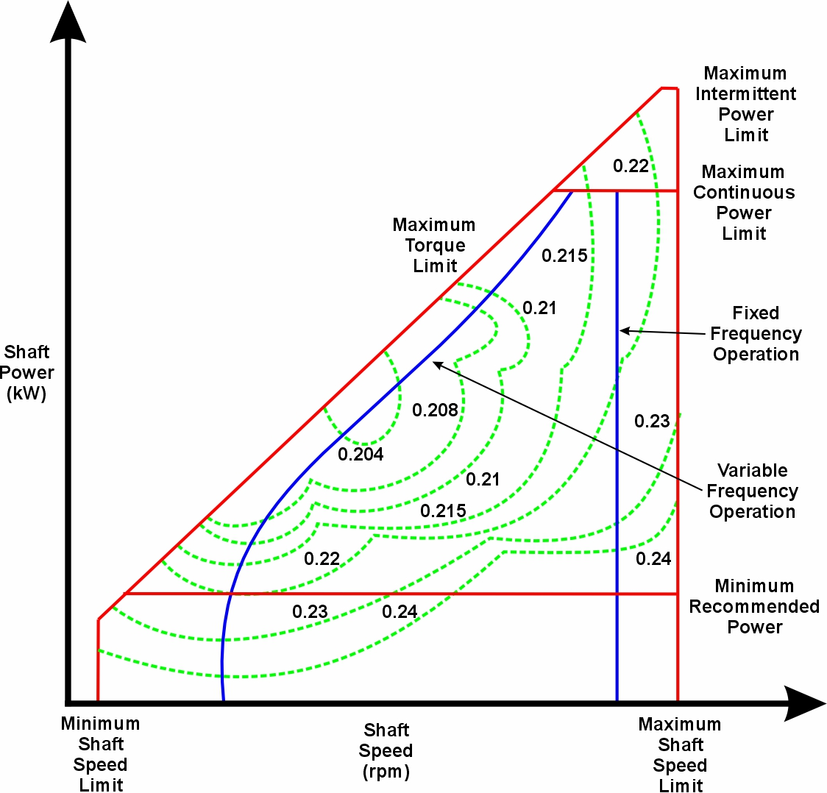
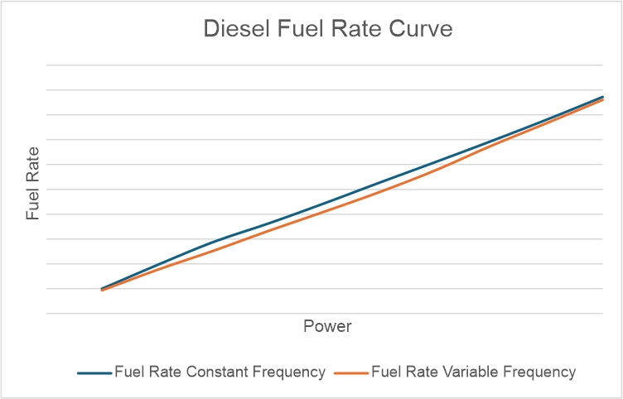
Diesel engine map – sfc curve – fuel rate curve

